Slide 1

Fashion-MNIST Classification: Comparative Analysis of ANN and CNN
Oghenebrume(brume) Akpadaka
P2887886
Neural Systems & NLP
MSc. Artifical Intelligence
14th November 2025

Slide 2
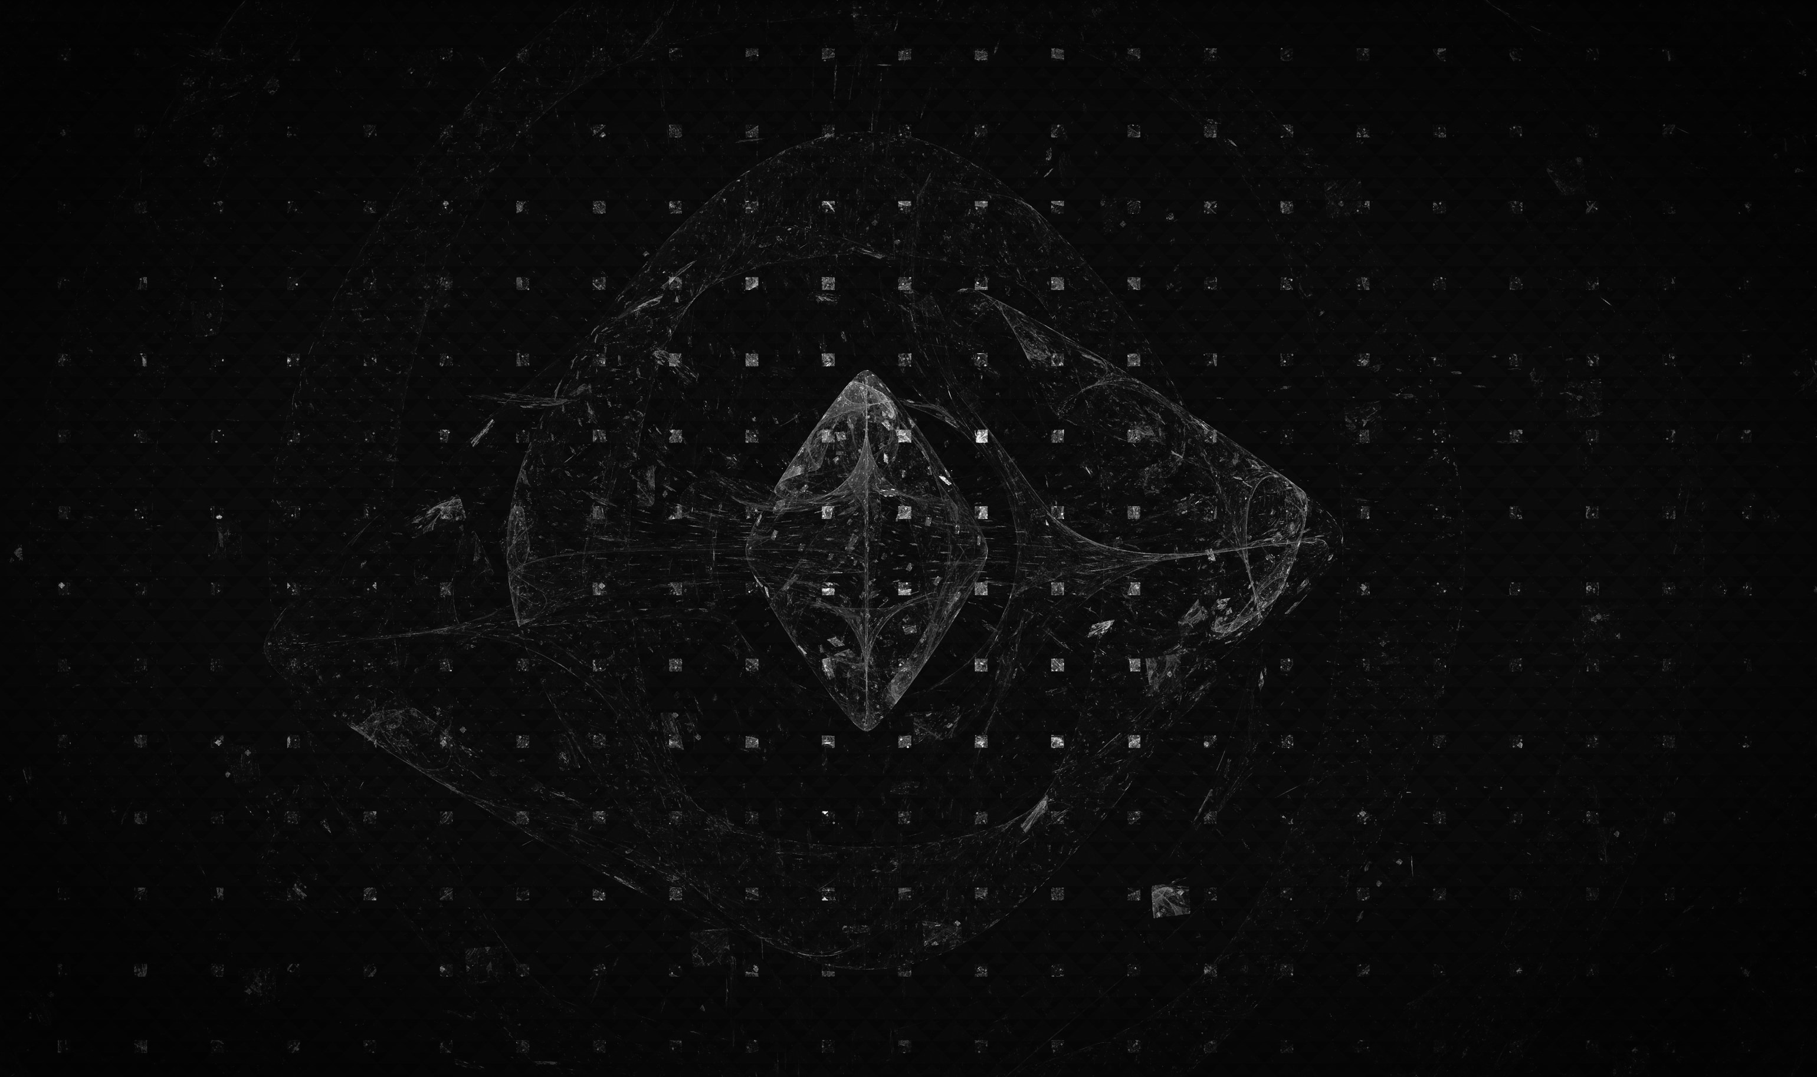
introducTION
Fashion-MNIST is a benchmark dataset of 70,000 grayscale images (28×28) used to test image-classification models in machine learning
The study compares two architectures — Artificial Neural Networks (ANN) and Convolutional Neural Networks (CNN) — to evaluate how network design influences accuracy and generalisation.
This topic was chosen to demonstrate practical understanding of deep learning frameworks and to replicate real-world image-recognition tasks efficiently.
The central problem: Which architecture provides better performance and generalisation for low-resolution image classification — ANN or CNN?

Slide 3
Objectives / Goals
To implement and compare two neural network models — ANN and CNN — for classifying fashion images using the Fashion-MNIST dataset.
To evaluate the effect of architectural design on model accuracy, convergence rate, and generalisation performance.
To demonstrate how regularisation, optimisation, and visualisation techniques enhance model robustness and interpretability.
To provide practical insight into selecting efficient deep learning architectures for image-recognition tasks

Slide 4
Methodology / Approach
The project followed a structured machine learning workflow: data preprocessing → model design → training → evaluation.
Dataset: Fashion-MNIST (70,000 grayscale images, 28×28 pixels, 10 classes).
Tools and Frameworks: Python, TensorFlow/Keras, NumPy, Matplotlib, and Scikit-learn.
Techniques:
Data normalisation to [0,1] for stability.
ANN: Fully connected dense layers with dropout (0.3).
CNN: Three convolutional blocks (filters = 32, 64, 128) with batch normalisation and max pooling.
Optimiser: Adam (lr = 0.001) with early stopping for convergence control.
Evaluation metrics: Accuracy, loss curves, confusion matrix, and classification report?

Slide 5
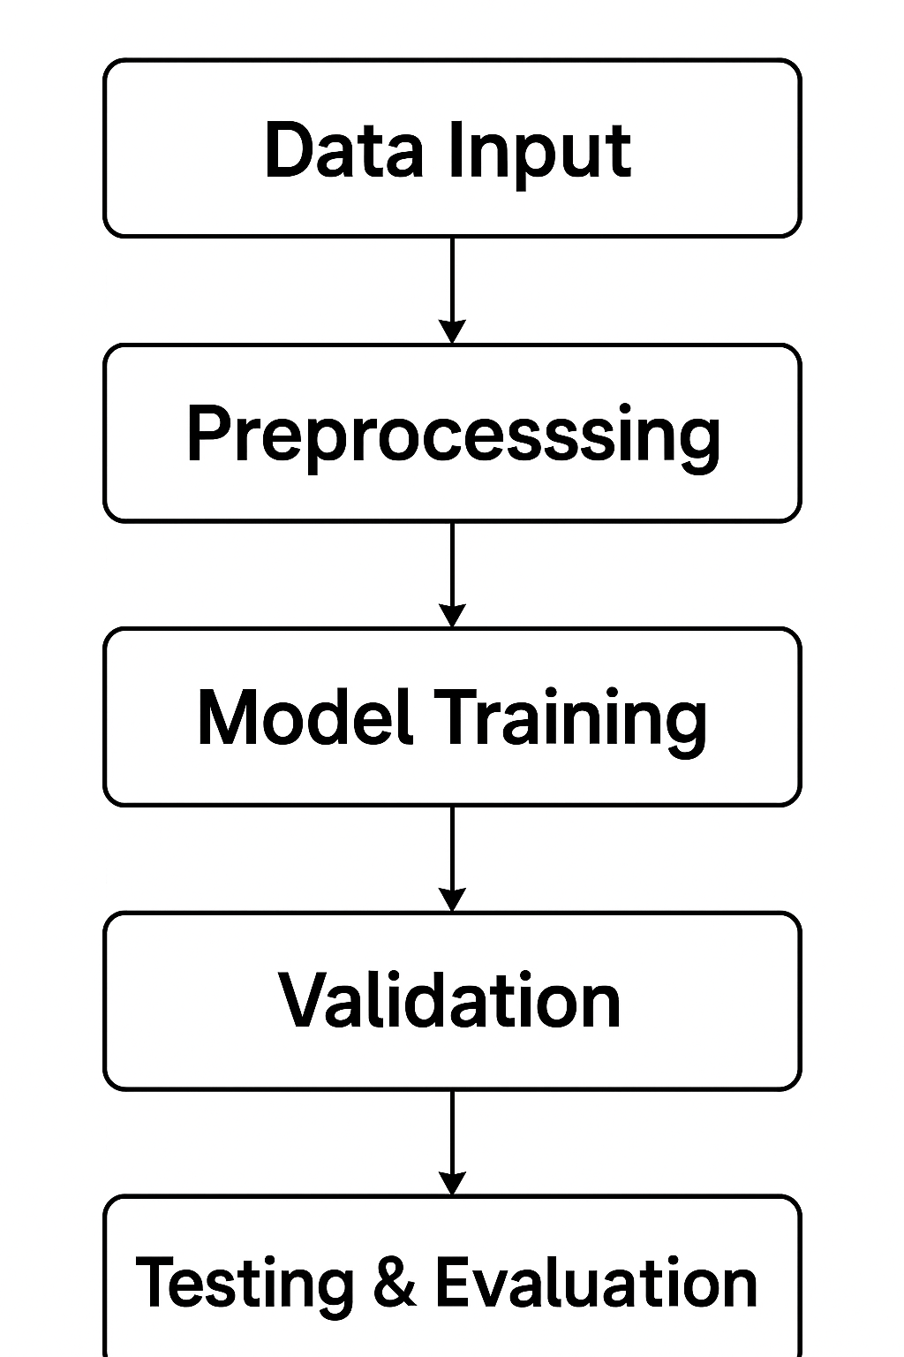

Slide 6
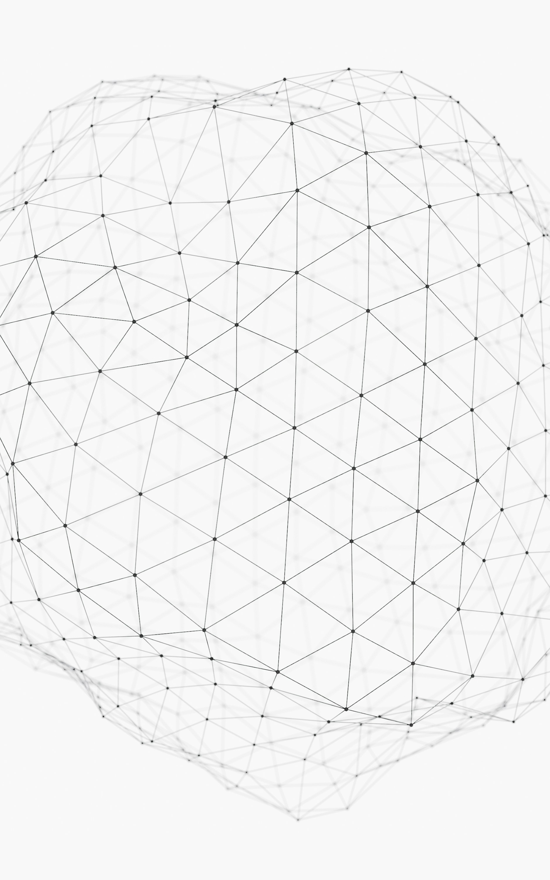
Data / Materials / Inputs
Dataset: Fashion-MNIST — 70,000 grayscale images (28×28 pixels) across 10 fashion categories (train: 60,000; test: 10,000).
Source: Official Fashion-MNIST dataset by Xiao et al. (2017), accessed via TensorFlow/Keras API.
Preprocessing Steps:
Pixel intensity normalised to [0, 1] for stable training.
Training data split into 50,000 training and 10,000 validation samples.
Labels converted to categorical format for ANN and integer encoded for CNN.
Key Parameters:
Batch size = 128, learning rate = 0.001, epochs ≤ 30, dropout = 0.3–0.4.
Early stopping applied with patience = 5 to prevent overfitting.

Slide 7
Implementation / Process
Step 1: Load and explore the Fashion-MNIST dataset (70,000 images).
Step 2: Preprocess data — normalise pixel values, reshape images, split into train/validation/test sets.
Step 3: Build and compile ANN and CNN architectures using TensorFlow/Keras.
Step 4: Train both models using the Adam optimiser with early stopping.
Step 5: Evaluate model performance using accuracy, loss curves, and confusion matrices.
Step 6: Compare results and interpret performance differences.

Slide 8
Results / Findings
Overall Performance:
ANN achieved 88.9% test accuracy
CNN achieved 91.0% test accuracy.
Observations:
CNN converged faster (≈ 9 epochs) compared to ANN (≈ 22 epochs).
CNN showed smoother validation curves and reduced overfitting.
Key Insights:
Both models performed strongly on distinct classes (e.g., Trousers, Sandals, Bags).
CNN reduced misclassifications in similar classes (Shirt, Coat, Pullover).

Slide 9
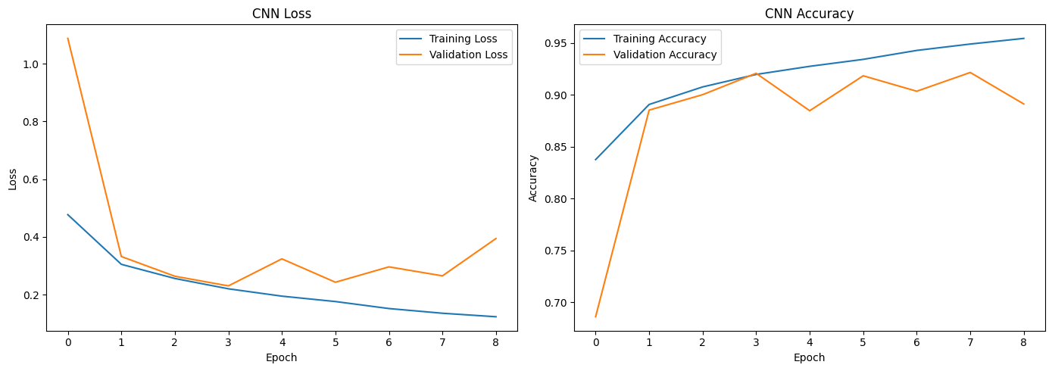
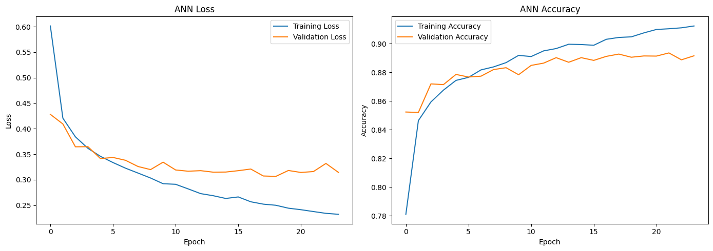

Slide 10
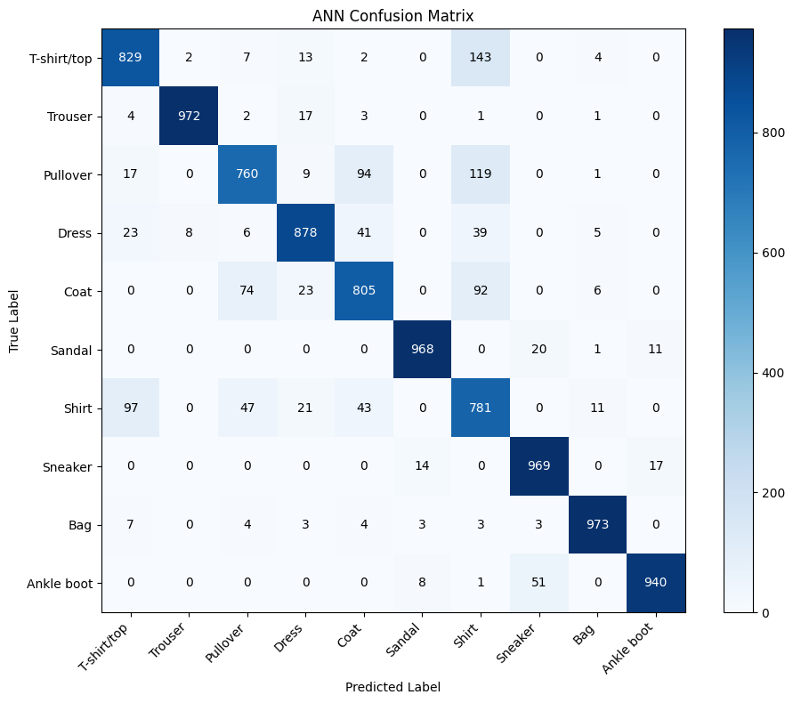
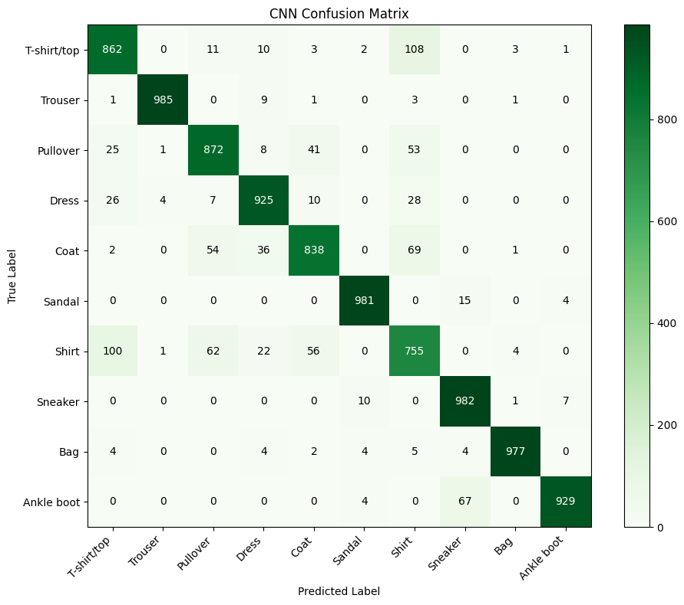

Slide 11
Discussion / Interpretation
Meaning of Results:
CNN’s superior accuracy confirms the advantage of convolutional layers in capturing spatial and textural features.
ANN performed well but lacked spatial awareness, leading to higher misclassifications among visually similar classes.
Key Insights:
Regularisation (dropout, batch normalisation) improved model stability and prevented overfitting.
Data normalisation and early stopping enhanced convergence efficiency.
Performance differences reflect the inductive bias of CNNs towards image data.
Challenges:
Misclassification in similar garment categories (shirt vs coat vs pullover).
Balancing model complexity with computational efficiency.
Managed through early stopping, tuning dropout rates, and using a consistent learning rate.

Slide 12
Conclusion / Summary
Project Achievement:
Successfully implemented and compared ANN and CNN models for Fashion-MNIST image classification using TensorFlow/Keras.
Achieved 91% accuracy with CNN versus 88.9% with ANN.
Key Learnings:
CNNs outperform ANNs by exploiting spatial relationships and local feature hierarchies.
Regularisation (dropout, batch normalisation) and early stopping improve model generalisation.
Data normalisation and adaptive optimisation (Adam) enhance training stability.
Contribution to the Field:
Confirms the effectiveness of convolutional architectures for visual recognition tasks.
Provides a reproducible benchmark for comparing deep learning models on structured datasets.
Reinforces the importance of architecture-driven learning in artificial intelligence research.

Slide 13

Future Work / Acknowledgments
Future Work:
Implement deeper CNN architectures (e.g., ResNet, MobileNet) for enhanced accuracy.
Introduce data augmentation (rotation, zoom, flips) to improve model robustness.
Apply learning-rate scheduling and cross-validation for optimisation and stability.
Explore transfer learning using pre-trained models on larger image datasets.
Extend the study to coloured or higher-resolution image datasets for greater realism
Acknowledgments:
Tools & Frameworks: TensorFlow, Keras, NumPy, Matplotlib, and Scikit-learn.
Dataset Source: Xiao, Rasul, & Vollgraf (2017) — Fashion-MNIST.
Inspiration & Guidance: Preda (2021) on Kaggle and LeCun et al. (1998) for foundational CNN research
.Support: Thanks to instructors, colleagues, and peers for academic guidance and feedback.

Slide 14

THANK YOU

